Slide 1

CS 506 | Team E
Police Overtime

Slide 2
Police Overtime | Team E
Goal:
Analyze the Boston Police Department's budget, especially overtime spending, to increase transparency and understanding.
Motivation:
To ensure responsible use of public funds in policing and address community concerns about police spending.
Policing in the United States has long been a contentious issue, balancing the need for public safety against concerns of bias and abuse of power. Recent scrutiny of police budgets, particularly regarding the necessity of military-grade equipment and the use of overtime spending, highlights the need for greater accountability and transparency.
Background:
By: Truc Duong, Jiawei Sun, Al Mbaye, Can Wang, Nurassyl Medeu

Slide 3
Project
Analysis
Progress
Division of Work
Datasets
Employee Earnings data
BPD Field activity data
Overtime data
Internal Affairs data
Suffolk Brady List data
Data was provided by client or found on public records
Completed weekly scrum reports
Imported and preprocessed all available data
Each member completes a set number of the client’s questions
Weekly analysis of data depending on the client’s set of questions

Slide 4
Early
Observations
Results
Visualization
Insights
Identification of discrepancies in overtime payments
Increased overtime as a result of social events (Boston Marathon Bombing, BLM Protests, etc)
Overtime and highest payment graphs
Ratio of overtime earnings graph
Year-over-year changes in court overtime graph
Indications of potential financial irregularities
Understanding the impact of social events on overtime usage

Slide 5
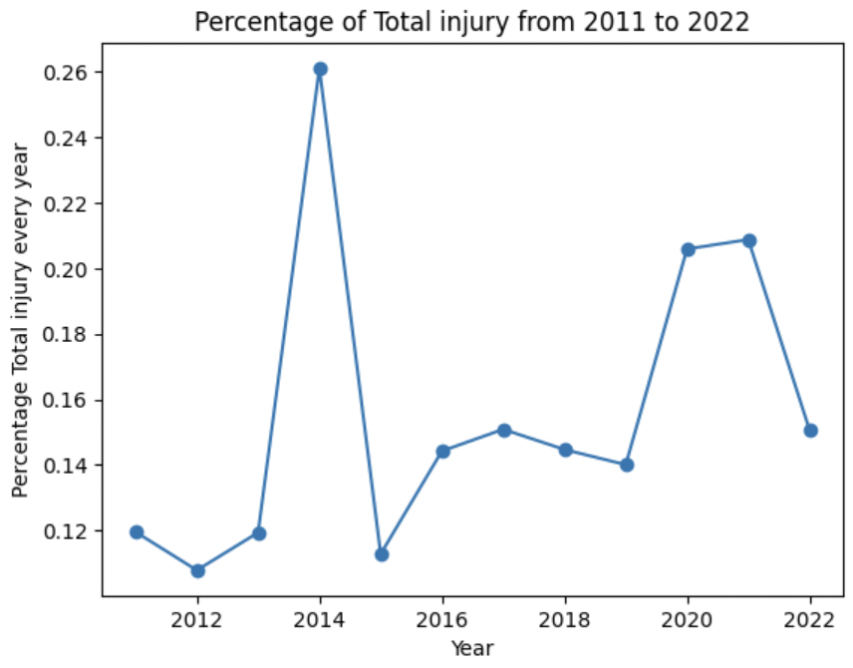
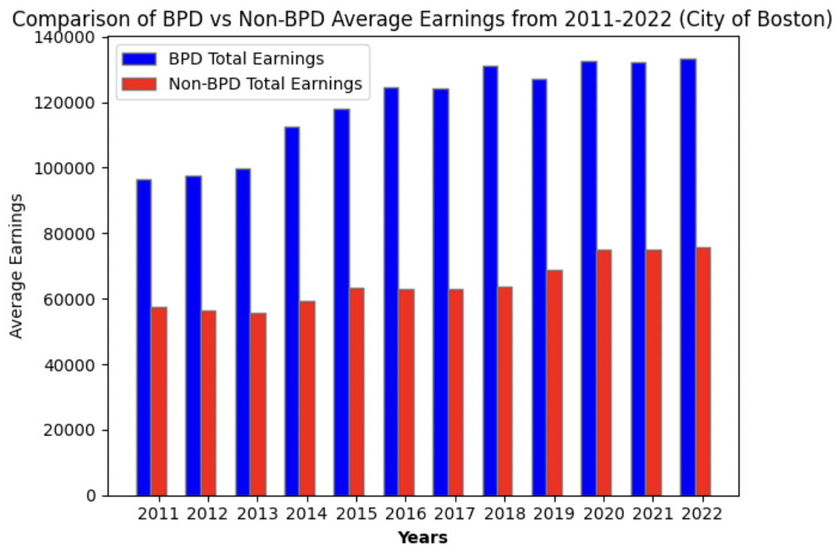
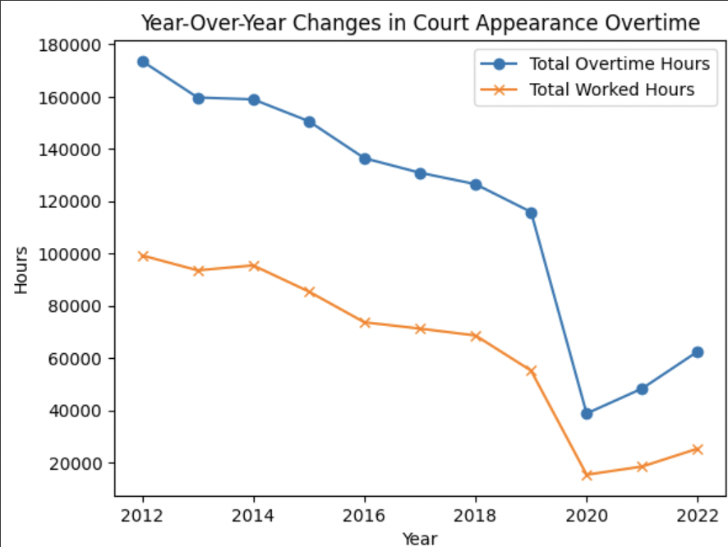
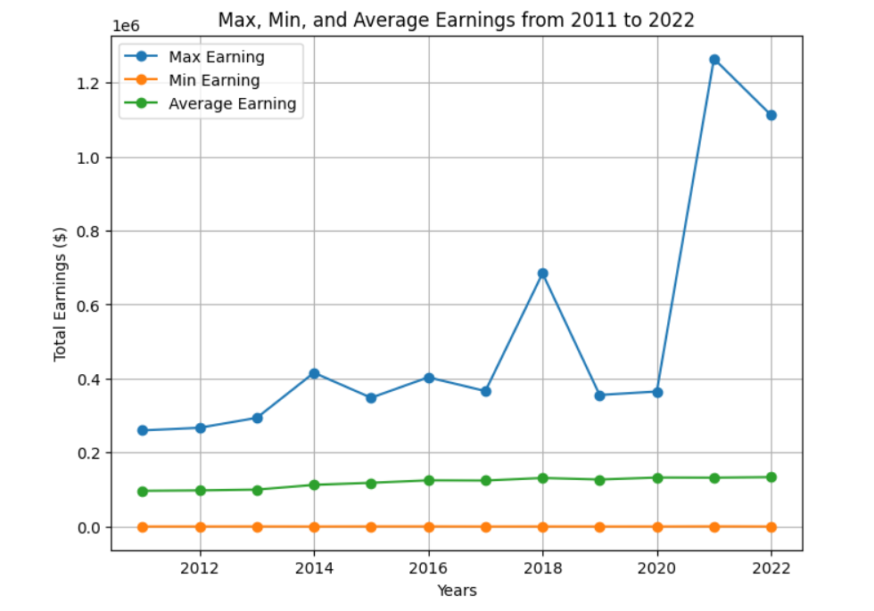
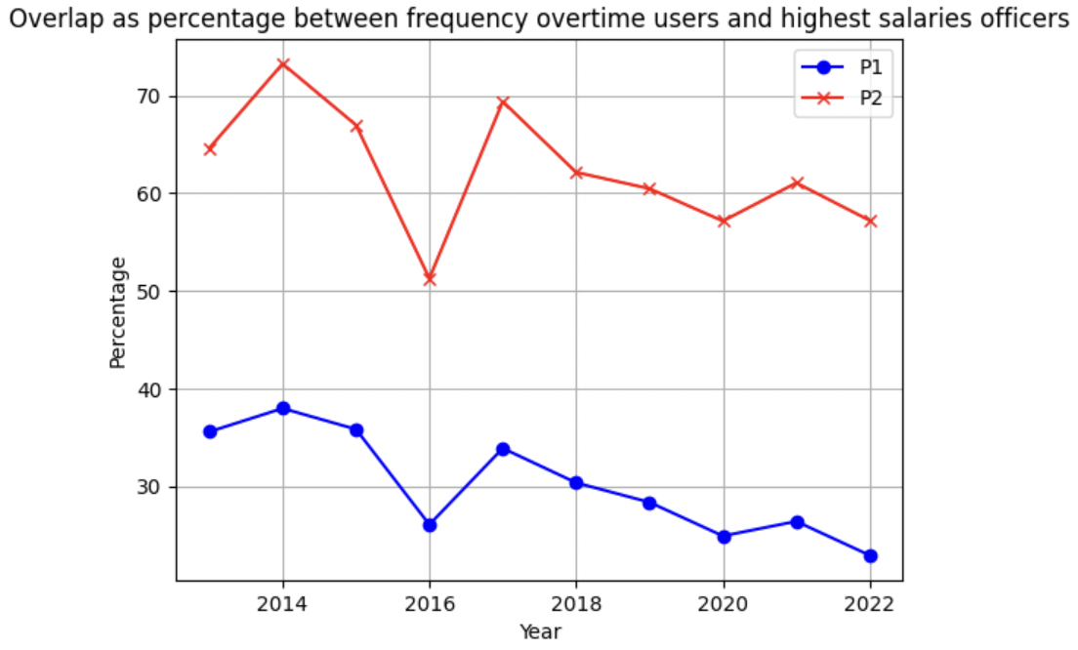
Visualization + Conclusion
The injury payment of BPD officers ranges from 5% to 25% of their overall payment and it increased overtime, with a peak in 2014
The average paycheck for non-BPD workers in the city of Boston was approximately half that of BPD employees from 2011 to 2022
An officer who had high income was very likely (>50%) to take overtime frequently
Overtime hours were consistently much higher than worked hours
There was a drop in both overtime and worked hours in 2020
BPD paychecks increased overtime
There was an abnormal increase from 2020 to 2022
Visualization
Insights

Slide 6
Challenges and
Limitations
Challenges
Assumptions
Next Steps/Plan
Inconsistent data formatting across years and datasets
Difficulty in obtaining comprehensive demographic data on BPD officers
Lack of knowledge about fields in provided dataset
Assumed a uniform overtime payment rate unless otherwise indicated
Assume the employer ID and name pair is unique
More detailed assumption for each base questions.
Deeper analysis with additional datasets
Integrate individual team members’ analysis into a comprehensive understanding
Draft extension + final report
Prepare client presentation

Slide 7
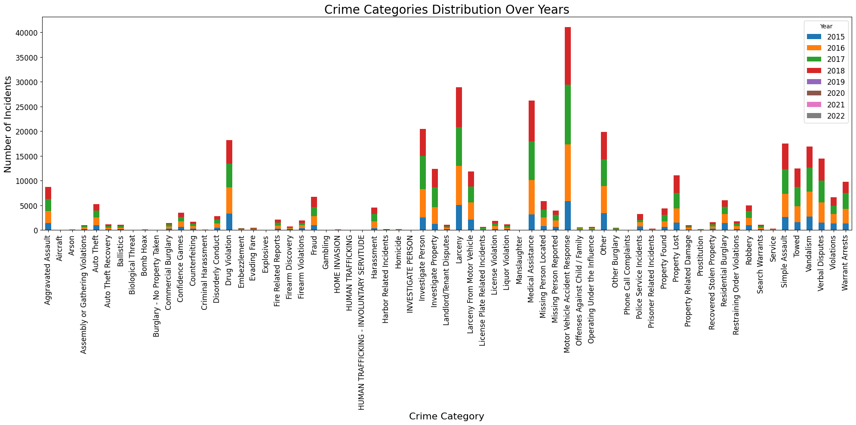
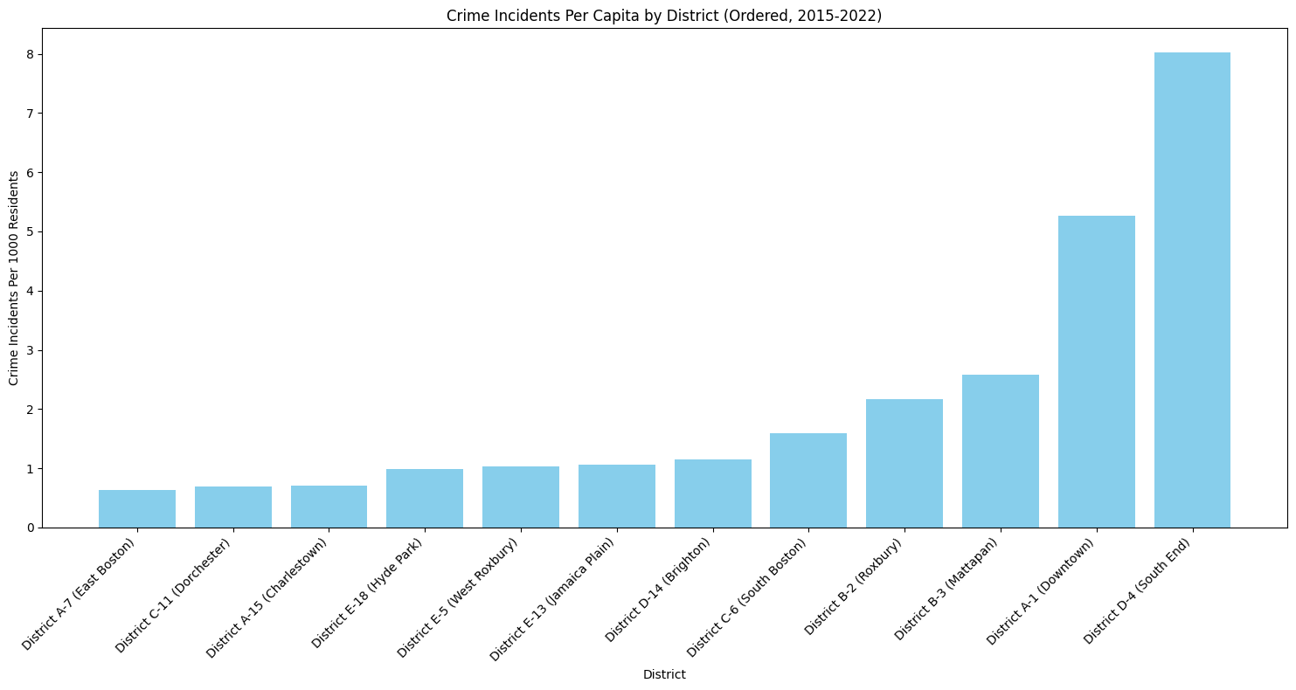
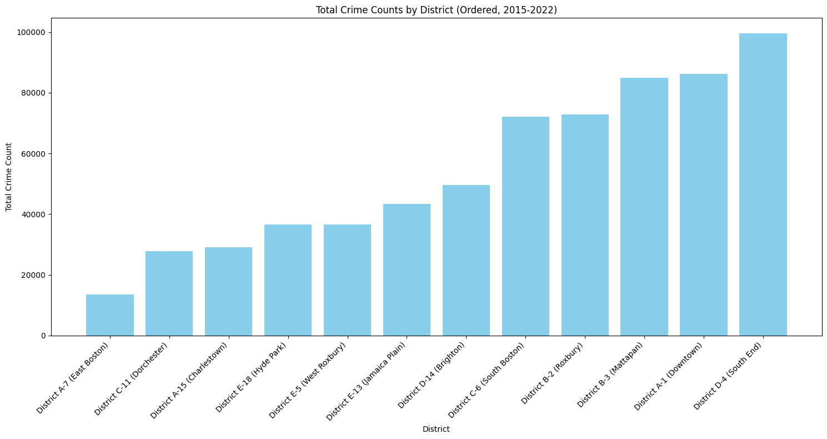
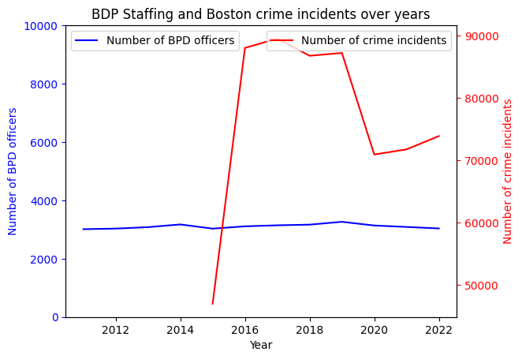
Project Extension Proposal
Number of officers is stable
Around 3000 each year
No clear indication of a strong linear relationship between the number of officers and the number of reported crimes
Further analysis required
Massive decrease in reported crime in 2020
Likely result of the COVID-19 pandemic
Not all categories are crimes
Many are emergency responses
Most common incidents:
Motor vehicle accident
Larceny (theft)
Medical (response)
Investigating individuals
Drug violations
Most active years
2018
2017
2016
Crime incidents per 1000 people
Population of districts vary from 10k to 125k
36k on average
South End has the highest crime rate
Despite having the smallest population
Downtown has 2nd lowest pop and 2nd highest crime rate
Most districts have fewer than 2 crime incidents per capita
South End is once again on top with nearly 100k crime incidents in 8 years
Dorchester and East Boston have the lowest total crime counts
Despite having 1st and 3rd highest population respectively
Visualization
Insights

Slide 8


Thank you for listening!
Team E

Slide 9
Project Extension Proposal
Number of officers is stable
Around 3000 each year
No clear indication of a strong linear relationship between the number of officers and the number of reported crimes
Further analysis required
Massive decrease in reported crime in 2020
Likely result of the COVID-19 pandemic
Visualization
Insights

Slide 10
Project Extension Proposal
Not all categories are crimes
Many are emergency responses
Most common incidents:
Motor vehicle accident
Larceny (theft)
Medical (response)
Investigating individuals
Drug violations
Most active years
2018
2017
2016
Visualization
Insights

Slide 11
Project Extension Proposal
Crime incidents per 1000 people
Population of districts vary from 10k to 125k
36k on average
South End has the highest crime rate
Despite having the smallest population
Downtown has 2nd lowest pop and 2nd highest crime rate
Most districts have fewer than 2 crime incidents per capita
Visualization
Insights

Slide 12
Project Extension Proposal
South End is once again on top with nearly 100k crime incidents in 8 years
Dorchester and East Boston have the lowest total crime counts
Despite having 1st and 3rd highest population respectively
Visualization
Insights

Slide 13
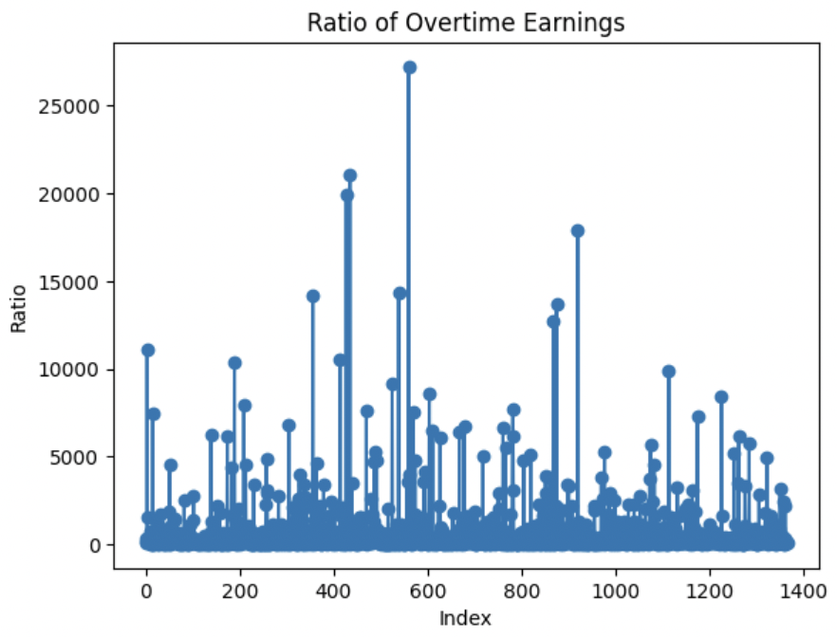
Visualization + Conclusion
The average paycheck for non-BPD workers in the city of Boston was approximately half that of BPD employees from 2011 to 2022
The injury payment of BPD officers ranges from 5% to 25% of their overall payment and it increased overtime, with a peak in 2014
An officer who had high income was very likely (>50%) to take overtime frequently
BPD paychecks increased overtime
There was an abnormal increase from 2020 to 2022
Visualization
Insights
Overtime hours were consistently much higher than worked hours
There was a drop in both overtime and worked hours in 2020
amount of overtime money paid per hour for each individual is not constant
May consist of wasteful overtime practice

Slide 14
Visualization + Conclusion
The injury payment of BPD officers ranges from 5% to 25% of their overall payment and it increased overtime, with a peak in 2014
Visualization
Insights

Slide 15
Visualization + Conclusion
An officer who had high income was very likely (>50%) to take overtime frequently
Visualization
Insights

Slide 16
Visualization + Conclusion
BPD paychecks increased overtime
There was an abnormal increase from 2020 to 2022
Visualization
Insights

Slide 17
Visualization + Conclusion
Overtime hours were consistently much higher than worked hours
There was a drop in both overtime and worked hours in 2020
Visualization
Insights

Slide 18
pretitle
title
Paragraph 1 Present with ease and wow any audience with Canva Presentations. Choose from over a thousand professionally-made templates to fit any objective or topic. Make it your own by customizing it with text and photos.
subtitle
heading 1
heading 2
Paragraph 2 Present with ease and wow any audience with Canva Presentations. Choose from over a thousand professionally-made templates to fit any objective or topic. Make it your own by customizing it with text and photos.
heading 3
heading 4
heading 5
heading 6
footer

Slide 19
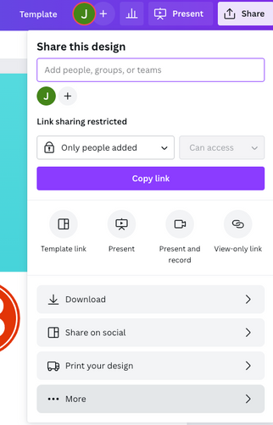
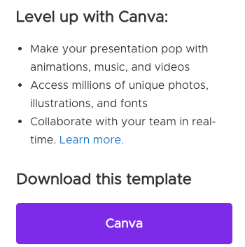
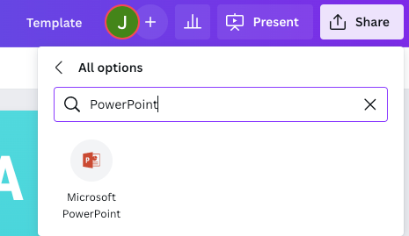
download this presentation as
a Powerpoint template in 3 steps
1
2
3
Click on the "Canva" button next to this presentation. Start editing your presentation. You may need to sign in to your Canva account.
Click on the "Share" button on the top right corner in Canva and click on "More" at the bottom of the menu.
Enter "PowerPoint" in the search bar and click on the PowerPoint icon to download.

Slide 20
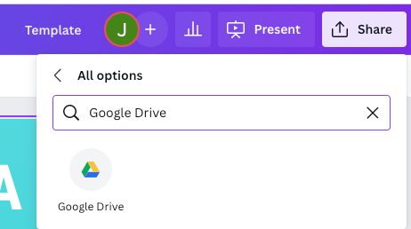
download this presentation as
a Google Slides template in 3 steps
1
2
3
Click on the "Canva" button next to this presentation. Start editing your presentation. You may need to sign in to your Canva account.
Click on the "Share" button on the top right corner in Canva and click on "More" at the bottom of the menu.
Enter "Google Drive" in the search bar and click on the Google Drive icon to add this design as a Google slide in your G Drive. It will ask you to link your Google account to Canva the first time.

Slide 21
01.
04.
Content name
Content name
02.
05.
Content name
Content name
03.
06.
Content name
Content name
table of contents

Slide 22
01.
section name

Slide 23

write your
topic or idea
Elaborate on what you want to discuss.

Slide 24

observations
add a main point
add a main point
add a main point
Elaborate on what you want to discuss.
Elaborate on what you want to discuss.
Elaborate on what you want to discuss.

Slide 25
write an original statement or inspiring quote
— Include a credit, citation, or supporting message

Slide 26
02.
section name

Slide 27

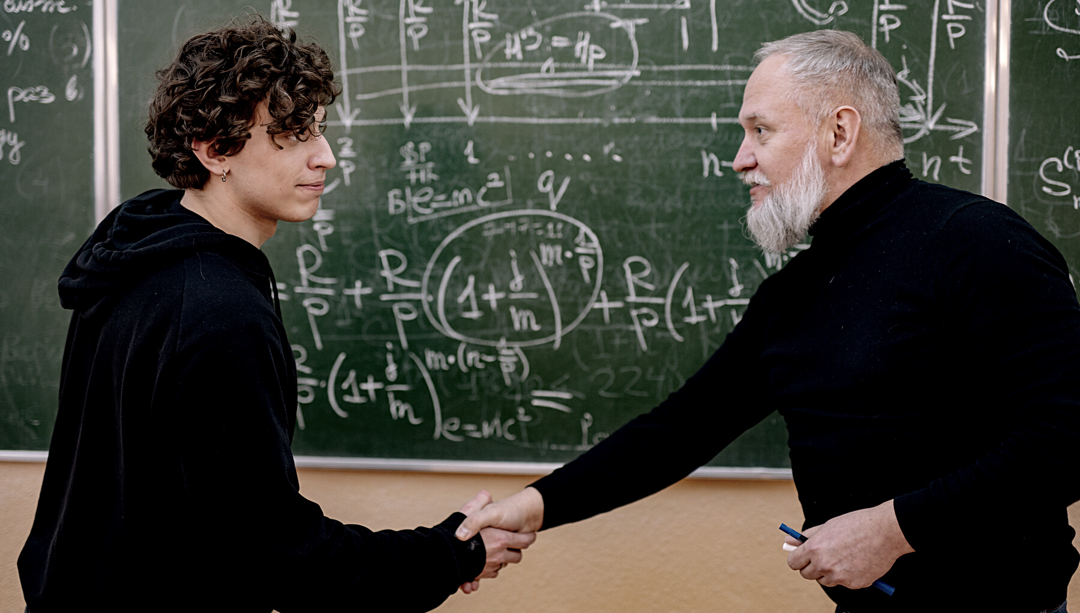
write your topic or idea
Add a main point
Add a main point
Briefly elaborate on what you want to discuss.
Briefly elaborate on what you want to discuss.
Add a main point
Add a main point
Briefly elaborate on what you want to discuss.
Briefly elaborate on what you want to discuss.

Slide 28

add a main point
Elaborate on what you want to discuss.
add a main point
Elaborate on what you want to discuss.
add a main point
study objectives
Elaborate on what you want to discuss.

Slide 29
03.
section name

Slide 30
write your topic or idea
Add a main point
Briefly elaborate on what you want to discuss.
Add a main point
Briefly elaborate on what you want to discuss.
Add a main point
Briefly elaborate on what you want to discuss.
Add a main point
Briefly elaborate on what you want to discuss.
Add a main point
Briefly elaborate on what you want to discuss.
Add a main point
Briefly elaborate on what you want to discuss.

Slide 31
04.
section name

Slide 32

2 out of 5
95%
12 million
Elaborate on the featured statistic.
Elaborate on the featured statistic.
Elaborate on the featured statistic.

Slide 33
schedule
1ST QUARTER
January
Double click to add task
February
Double click to add task
March
Double click to add task
2ND QUARTER
April
Double click to add task
May
Double click to add task
June
Double click to add task
3RD QUARTER
July
Double click to add task
August
Double click to add task
September
Double click to add task
4TH QUARTER
October
Double click to add task
November
Double click to add task
December
Double click to add task

Slide 34
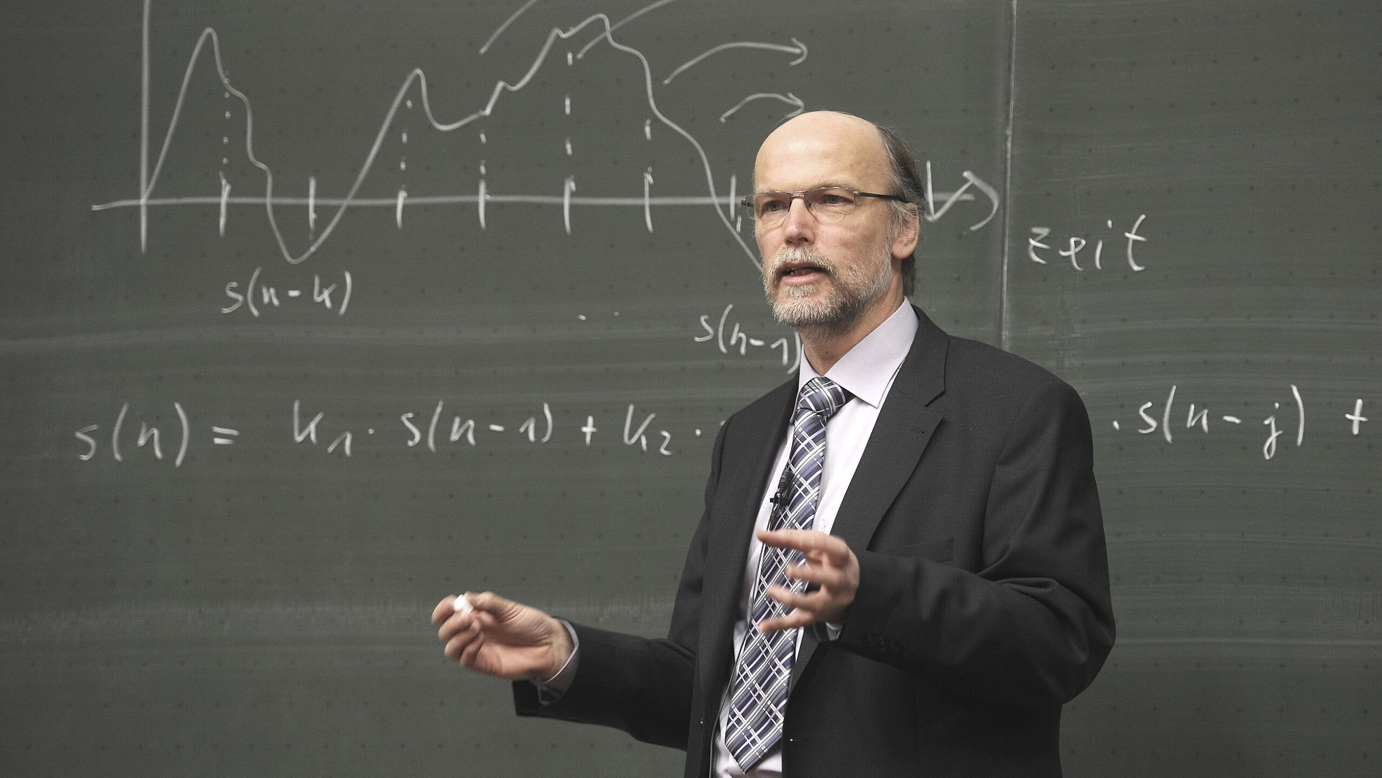
write a heading here

Slide 35
05.
section name

Slide 36


Write a caption for
the photos.

Slide 37
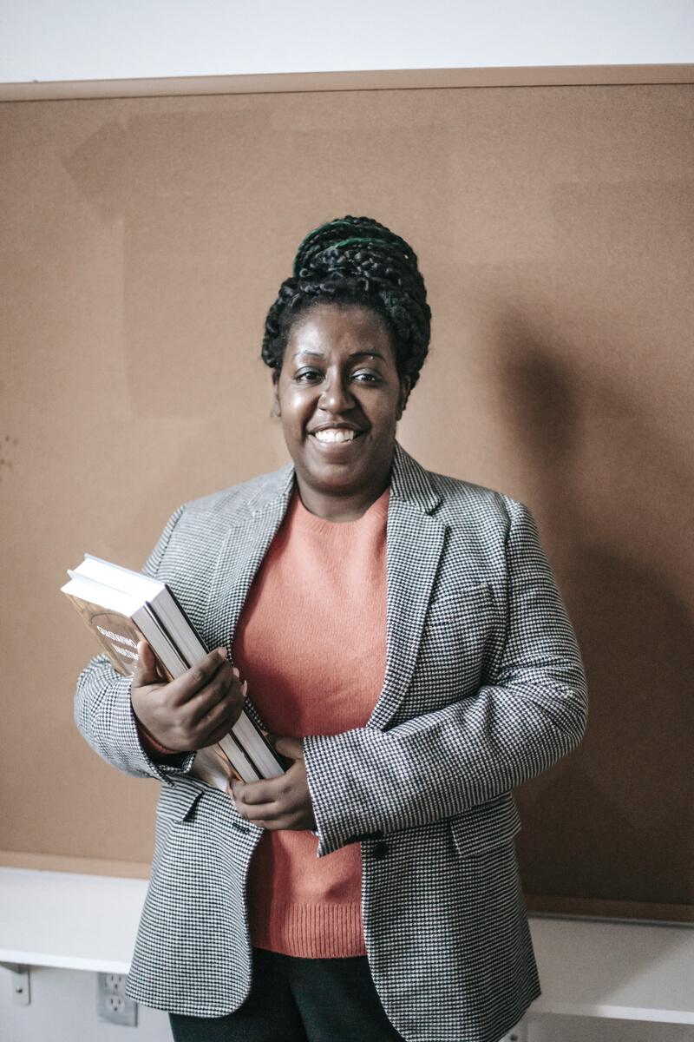
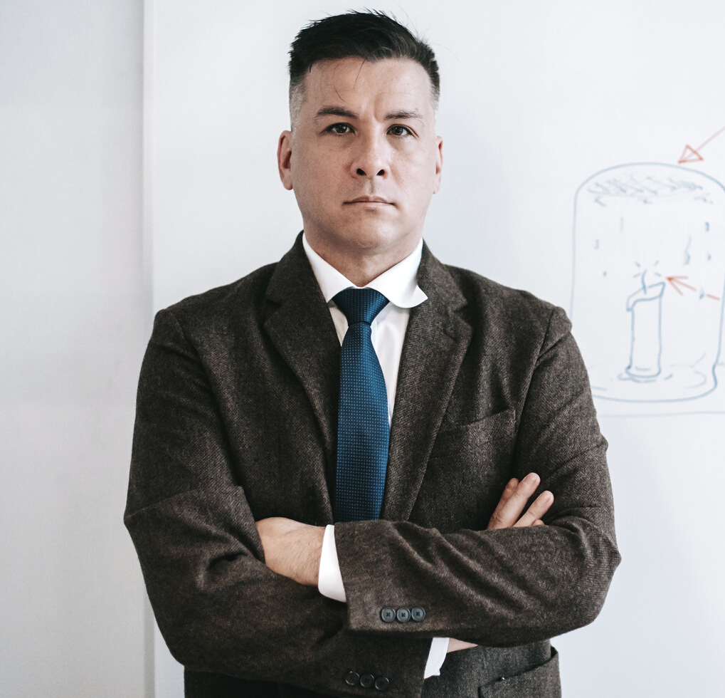


add a team
members page
Elaborate on what you want to discuss.
Name
Name
Name
Name
Title or Position
Title or Position
Title or Position
Title or Position

Slide 38

get in touch
Email
hello@reallygreatsite.com
Social Media
@reallygreatsite
Call us
123-456-7890

Slide 39

This presentation template is free for everyone to use thanks to the following:
SlidesCarnival for the presentation template
Pexels for the photos
happy designing!
credits

Slide 40



This presentation template uses the following free fonts:
Titles: Playfair Display Black
Headers: Roboto
Body Copy: Roboto
You can find these fonts online too.
Happy designing!
fonts in this presentation

Slide 41
add a timeline page
Add a main point
Add a main point
Add a main point
Elaborate on what you want to discuss.
Elaborate on what you want to discuss.
Elaborate on what you want to discuss.
Add a main point
Add a main point
Add a main point
Elaborate on what you want to discuss.
Elaborate on what you want to discuss.
Elaborate on what you want to discuss.

Slide 42
swot analysis
S
O
What are you doing well?
What sets you apart?
What are your good qualities?
What are your goals?
Are demands shifting?
How can it be improved?
Where do you need
to improve?
Are resources adequate?
What do others do better than you?
W
T
What are the blockers
you're facing?
What are factors outside of
your control?

Slide 43

analysis of the results
25
20
Elaborate on what you want to discuss.
15
10
5
0
Item 1
Item 2
Item 3
Item 4
Item 5

Slide 44
Name
add a chart page
Job Title
Name
Name
Job Title
Job Title
Name
Name
Name
Name
Job Title
Job Title
Job Title
Job Title

Slide 45







































resource
page
Use these design resources in your Canva Presentation. Happy designing!
Don't forget to delete this page before presenting.

Slide 46

free templates for all your presentation needs
For PowerPoint, Google Slides, and Canva
100% free for
personal or commercial use
Ready to use, professional, and customizable
Blow your audience away with attractive visuals

